Slide 5
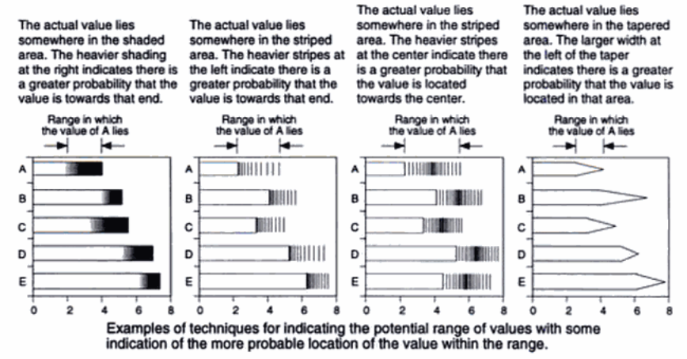
Notes:
https://books.google.co.uk/books?id=LT1RXREvkGIC&printsec=frontcover&hl=en#v=onepage&q&f=false

Slide 6
